Slide 1


WWC Belfast NOV 2014
Introduction to Git
Presented by
Stephen McCalden
www.twitter.com/SMcCalden
www.GitHub.com/SMcCalden

Slide 2




Introduction to Git
What is GitHub?
It is a popular open source online source control application to assist with the storage and tracking of a version-controlled file set.
They are a distributed version control system allowing multiple editors to work on the same project from remote locations. Other similar version control tools are SVN, CVS or Mercurial .

Slide 3

Introduction to Git
What is source control?
This is the process of tracking every edit that is made to any file contained within a controlled file set.
It stores individual file versions along with the editors that make them so at any time during the project lifespan a specific edit can be traced back to the time the edit was made.
This enables a project owner to easily revert back to working file versions should an issue be found whilst also keeping the main current deployable version safe and secure at all times.

Slide 4
Introduction to Git
The basic principles you’ll need to know…
Forking, Initialisation & Cloning
1
2
Pull Requests
Branches
3
Adding, Editing and Committing
4
5
Push Requests
Merging
6

Slide 5
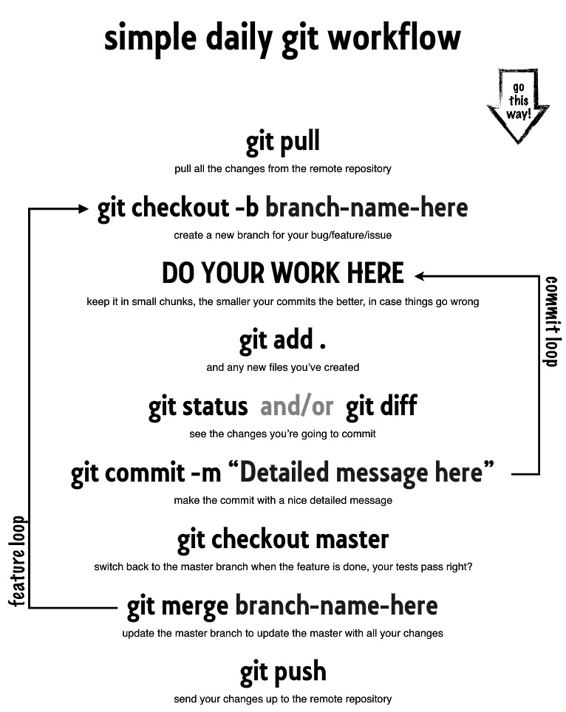

Introduction to Git

Slide 6

Introduction to Git
Miscellaneous
Gitignore – a file at the root level of the repo defining file extensions which should be excluded from committing (eg. IDE project-specific files)
README.md – A useful file which contains descriptive, installation, execution info. “m” in GitHub to view the precise syntax
Stashing – The idea of excluding a changed file from a commit and push and enable a partial commit. Feature branching is a better mechanism here in my opinion.
SSH Keys – Some remote repos employ double security by utilising public/private key authentication.
GitLab – This is a cut-down version of GitHub which is available for a local, more secure installation
GitRef - http://gitref.org/index.html
Git Guide - http://rogerdudler.github.io/git-guide/
GitHub - https://github.com/
Git Client - http://windows.github.com/ or http://mac.github.com/
SourceTree - http://www.sourcetreeapp.com/

Slide 7


Introduction to Git
Demo….

Slide 8
Questions??
Presented by
Stephen McCalden
www.twitter.com/SMcCalden
www.GitHub.com/SMcCalden

